Slide 1
Student Performance Analysis: Factors, Trends, and Insights
Project 2 – Python Visualization & Interactive Dashboard
Tools: Python, Flask, Seaborn, Plotly, AWS EC2
Members –
Anisha Peddireddy
Sai Gottumukkala
Sai Pavan Sagi

Slide 2
Project Overview
01
Explore factors influencing student performance
02
Focus: Study habits, attendance, parental involvement, socio-economic background
03
Tool used: Python, VSCode, AWS
04
Objective: Build an interactive dashboard using Python and Enable real-time filtering and web-based insights

Slide 3

Dataset Overview
Dataset: StudentPerformanceFactors (Kaggle)
Records: 6,607 students
Key Fields:
Exam_Score
Hours_Studied
Attendance
Motivation_Level
Family_Income
Gender

Slide 4
Dataset Overview
Dataset: StudentPerformance (Kaggle)
Key Fields:
Gender
Parental education
Lunch
Test prep
Exam scores

Slide 5

Tech Stack
Frontend: HTML, CSS, JS
Visualizations: Seaborn, Matplotlib, Plotly
Hosting: AWS S3 Bucket (Free Tier)

Slide 6

Web Dashboard Features
Real-time generation of plots
Dynamic web interface using HTML templates
Integrated with Tableau Dashboard

Slide 7
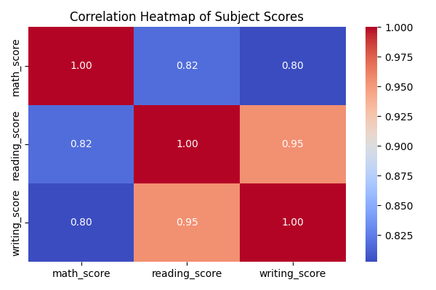
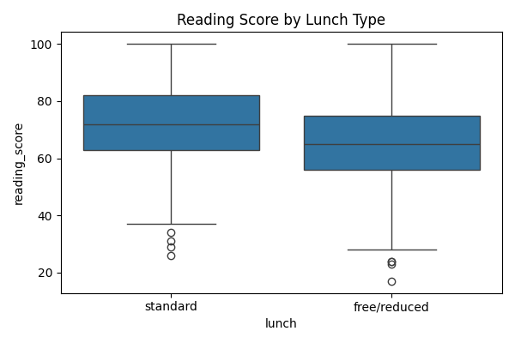
Visualization Panel 1: Heatmap & Boxplot

Slide 8
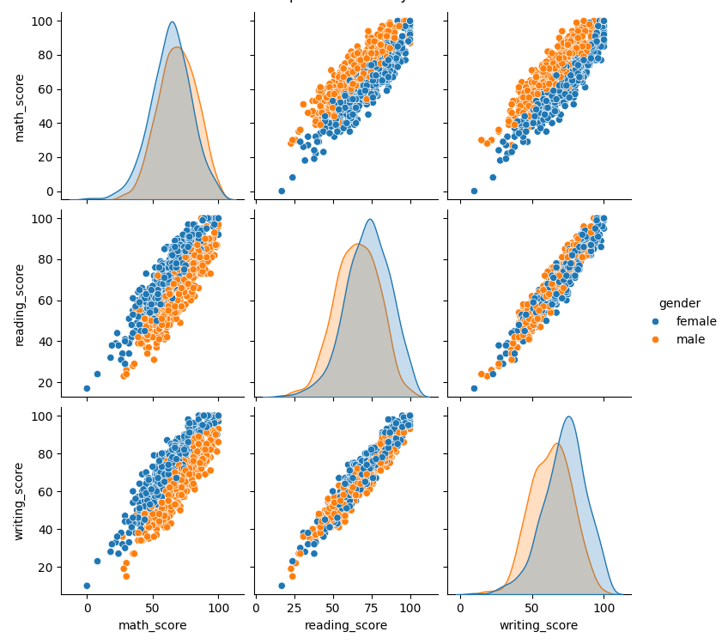
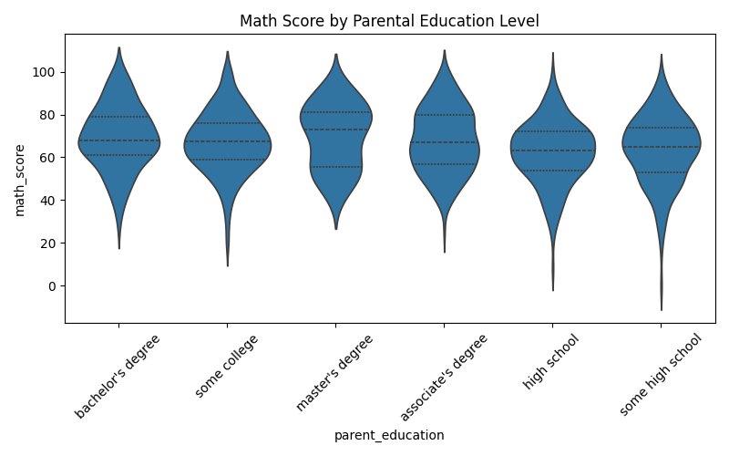
Visualization Panel 2: Pairplot & Violin Plot

Slide 9

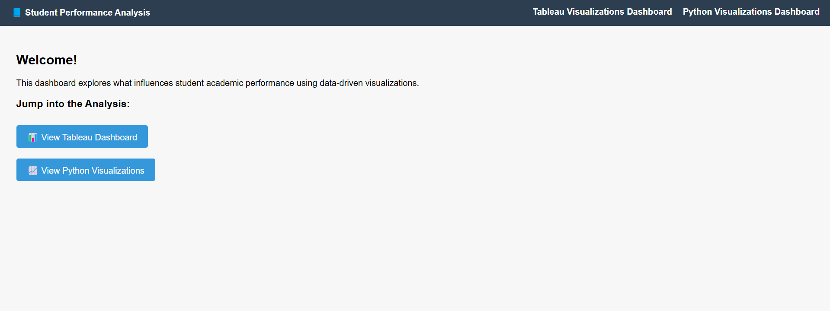
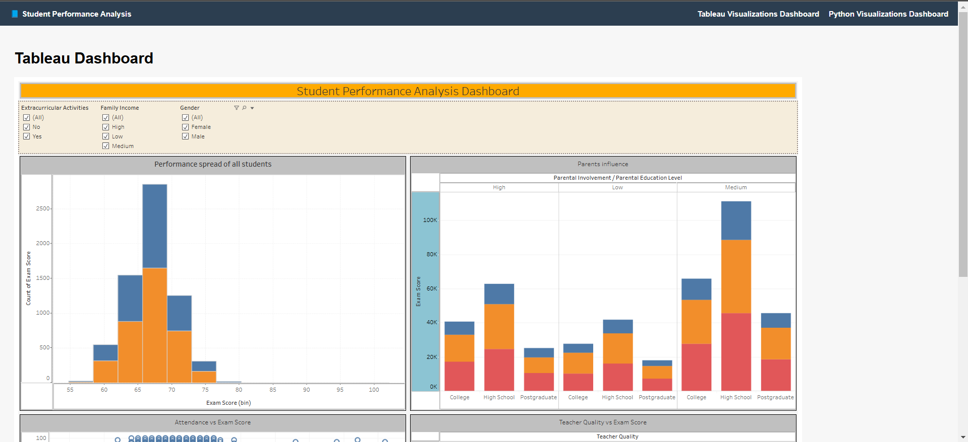
WebPage

Slide 10
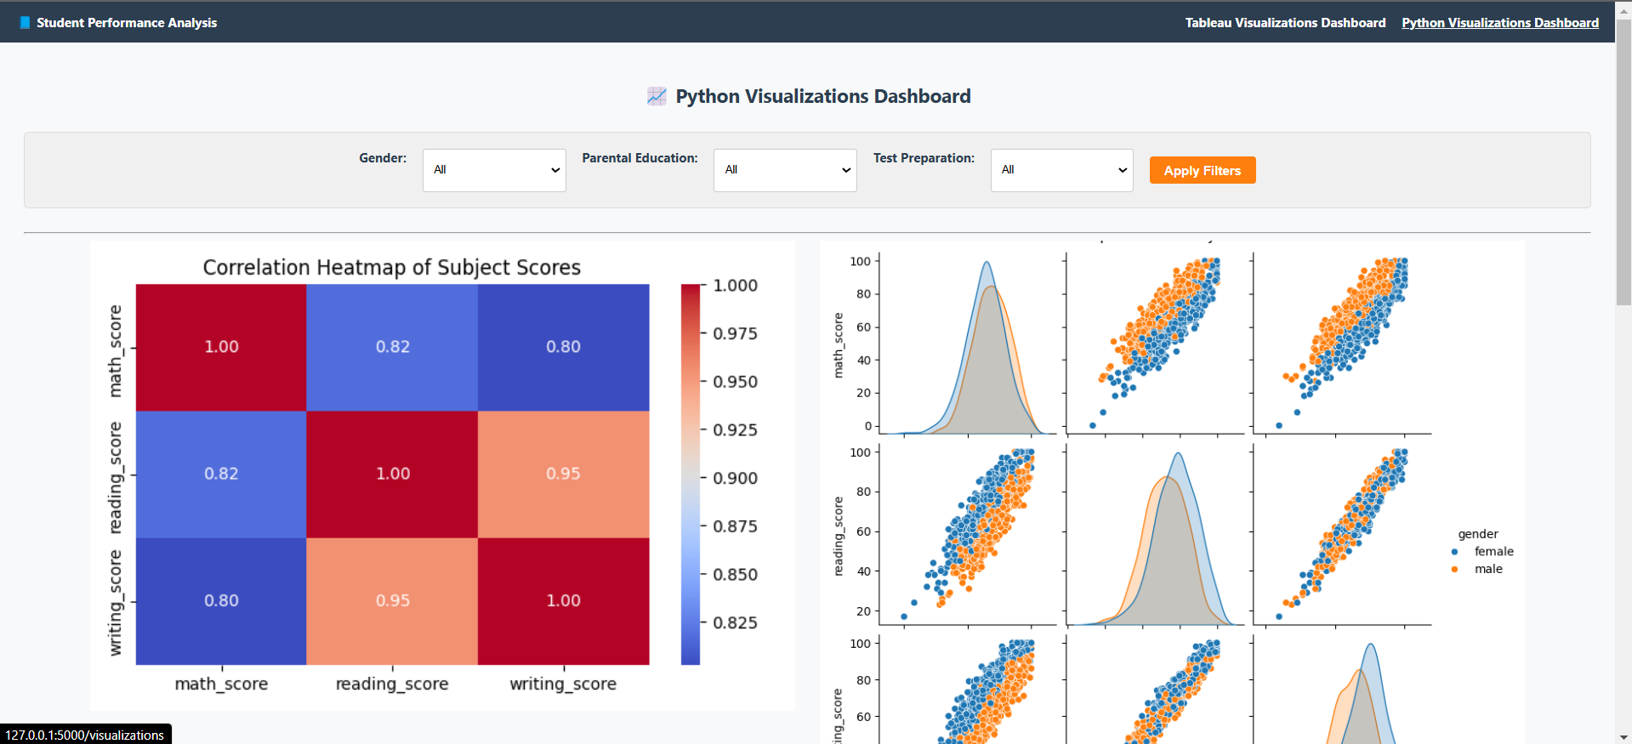
WebPage
Webpage Public URL - http://studentperfromance.s3-website.us-east-2.amazonaws.com/index.html

Slide 11

Key Insights
Visualization | Key Insight
Overall Score Distribution | Most students score between 60–80 in all subjects
Study Hours vs Exam Scores | Positive linear trend between study hours and exam performance
Attendance Trend | Higher attendance correlates with improved academic outcomes
Family Income & Parental Involvement | Students from higher income families or with more involved parents perform better
Gender Comparison | Female students tend to perform slightly better in reading and writing

Slide 12
Key Insights
Visualization | Key Insight
Correlation Heatmap | Strong correlation between reading and writing scores
Pairplot by Gender | Females consistently outperform males in reading and writing scores
Violin Plot: Parental Education vs Math | Higher parental education shows upward trend in math scores
3D Scatter: Math vs Reading vs Writing | Most students cluster in mid-range scores; top performers are multi-subject strong
Box Plot: Lunch vs Reading Score | Students with standard lunch score better in reading
Test Prep Impact | Students who completed test prep scored significantly higher on average

Slide 13
Key Insights Summary
Factor/Theme | Tableau Insight | Python Insight | Correlation Summary
Study Habits | More study hours → higher exam scores (scatter plots) | 3D scatter & trendlines show direct relationship with average scores | Both confirm study time as a strong, consistent predictor of performance
Parental Education | Higher parental education → better scores (stacked bar) | Violin plot shows score distribution improves with higher parental education | Strong agreement: Parental education significantly affects student outcomes
Attendance | Better attendance → higher performance trend (line graph) | 3D clustering suggests top scorers are likely more regular attendees | Tableau shows direct trend; Python reinforces through performance clustering
Gender Performance | Females outperform males in reading/writing (grouped bar) | Pairplot clearly shows higher reading/writing scores for females | Consistent gender-based performance gap observed in both visualizations
Socioeconomic Status | Higher income → better academic performance (income vs scores) | Students with standard lunch (proxy for income) scored higher (box plot) | Lunch-based insight strongly reinforces income-based trends from Tableau
Test Preparation | Test prep completion → better subject scores (bar charts) | Bar chart shows prep-completed students outperform in all subjects | Strong agreement: test prep has positive cross-subject impact

Slide 14

Team Contributions
Member | Project 1 – Tableau Dashboard | Project 2 – Python Web Dashboard
Anisha Peddireddy | Created Tableau visualizations, performed data cleaning | Implemented Flask routing, integrated Python visualizations, deployed on AWS EC2
Sai Gottumukkala | Engineered key features like average score & grade | Developed visualization logic using Seaborn/Plotly, applied color themes matching Tableau
Sai Pavan Sagi | Wrote documentation, crafted visual storytelling in Tableau | Designed HTML/CSS layout, handled presentation and user interface polish

Slide 15

Thank You / Q&A
Thanks for your time!
We welcome any questions or feedback

